Slide 1
Ubuntu Server 20.04.2
...Adding GUI Desktop to Ubuntu Server
Waikato Linux Users Group
Ian Stewart
2021-05-24

Slide 2
Ubuntu Server 20.04.2
Does NOT run ‘live’ from a USB stick.
Install Guide:
https://ubuntu.com/server/docs/install/step-by-step
Upon completing installation can add ‘tasksel’
$ sudo apt install tasksel
$ tasksel
Perform on-line adding and removing of the various GUI Desktop flavours using tasksel.

Slide 3
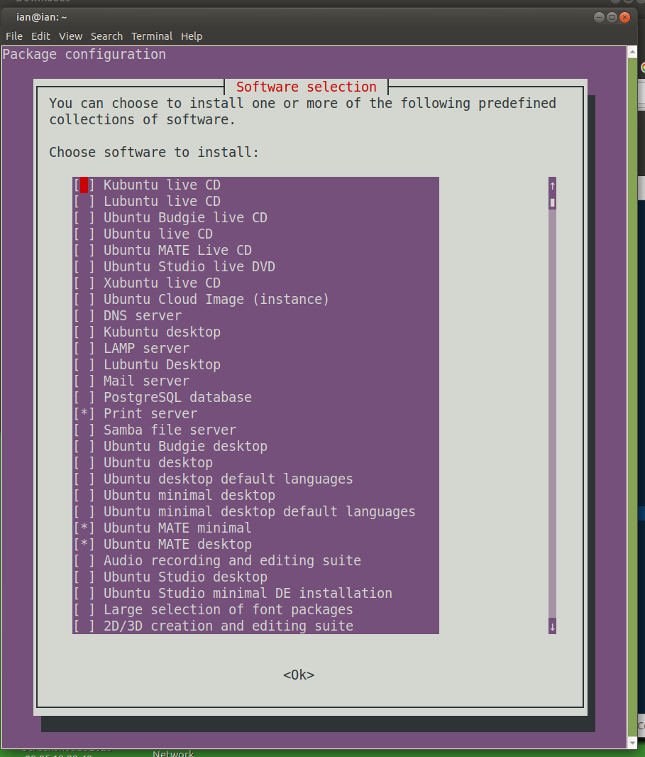
Tasksel options...

Slide 4
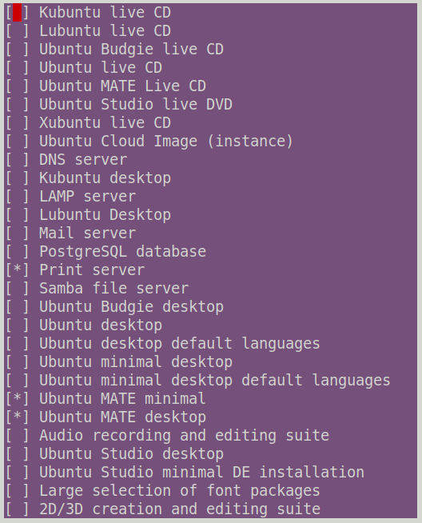
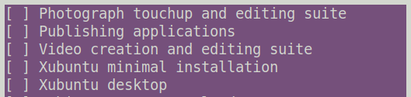
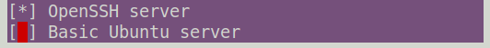

Slide 5
Ubuntu Server 20.04.2
After installing a GUI desktop the system will boot to a GUI.
Turn Desktop GUI off and go back to being a server with:
$ sudo systemctl set-default multi-user
...and do a...
$ startx
...when you want a GUI Desktop.
...or have GUI desktop on boot with...
$ sudo systemctl set-default graphical

